Slide 1
2023-04-21

Slide 2
Upcoming Schedule
Monday | Wednesday | Friday
04/17/2023 (90) • Review: Unit 5, Unit 9 • AP CS Question 2: Classes | 04/19/2023 (90) • Review: Units 6-7 • AP CS Question 3: Array/ArrayList | 04/21/2023 (45) • Review: Unit 10 • More recursion exercises like we did on Apr-7
04/24/2023 (90) • Review: Unit 8 • AP CS Question 4: 2D Array | 04/26/2023 (90) • AP CS Multiple Choice Game | 04/28/2023 (45) • Review: Unit 7, Unit 10 • Algorithms: Iterative/recursive binary search, selection sort, insertion sort, merge sort
05/01/2023 • FINAL | 05/03/2023 • AP EXAM

Slide 3
Unit 10
Recursion

Slide 4
Recursive Terminology
Recursion | Recursive Programming
The definition of an operation in terms of itself. Solving a problem using recursion depends on solving smaller occurrences of the same problem. | Writing methods that call themselves to solve problems recursively. An equally powerful alternative to iteration (for, while loops, etc.) Particularly well-suited for solving certain types of problems.

Slide 5
Recursive Terminology
Base Case | Recursive Case
The base case of a recursive method is the case where it does not recursively call itself, that is, the method terminates. The base case is a problem that is so simple, we already know the answer to it! | The recursive case, or general case, is the case where the method calls itself. It's called the general case because it's the case that usually happens when a recursive algorithm is executing. For the algorithm to work, the recursive case must diminish the problem so that it eventually approaches the base case.
Some recursive algorithms have more than one base or recursive case, but all have at least one of each. A crucial part of recursive programming is identifying these cases.

Slide 6
Tracing Recursive Methods
On the the AP Exam, you may be asked to trace through "mystery" recursive methods and determine what is returned or output.
This isn't as simple as tracing through loops, where you can build a trace table, because a recursive method may call itself and then do additional manipulation on the result.
What you can do is draw a box every time you encounter a recursive call, and inside that box, determine the result of that recursive call.
(This may require drawing more boxes inside the boxes, recursively...)

Slide 7
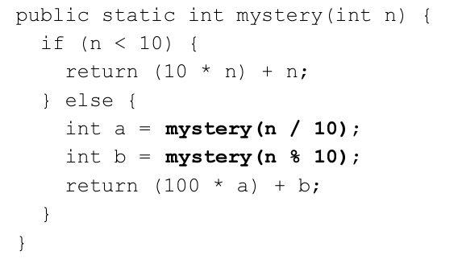
Recursive Tracing
Consider the following recursive method.
What is the result of mystery(348)?

Slide 8
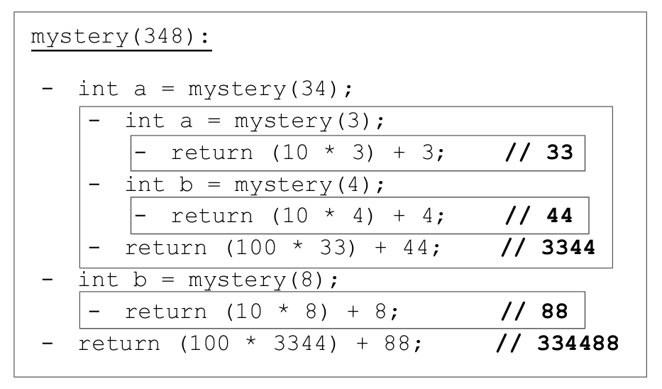
Recursive Trace

Slide 9
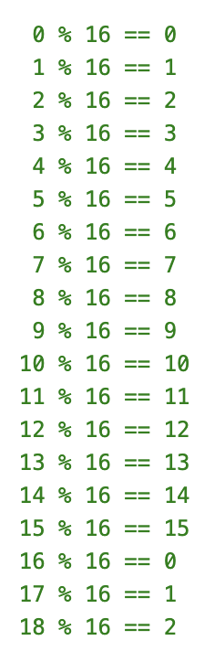
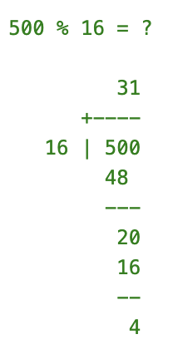
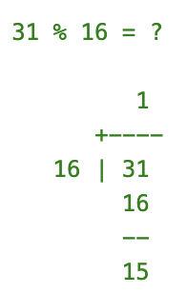
Calculating modulo (%)

Slide 10
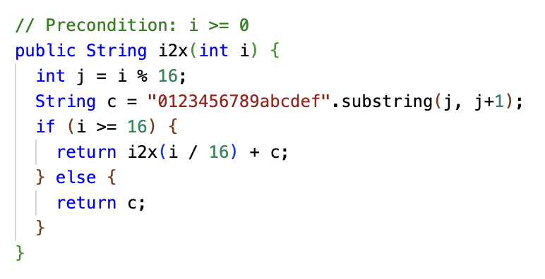
Recursive Trace Exercise (10 minutes)
What is printed?
System.out.println(i2x(15));
System.out.println(i2x(500));

Slide 11
Recursive Trace Exercise (10 minutes) – ANSWERS
What is printed?
System.out.println(i2x(15)); > f
System.out.println(i2x(500)); > 1f4
i2x(500) = i2x(500 / 16) + "4" = i2x(31) + "4"
= (i2x(31 / 16) + "f") + "4" = i2x(1) + "f" + "4" = "1" + "f" + "4" = "1f4"

Slide 12
i2x(500)
j = 500 % 16 = 4
c = "4"
i2x(500 / 16 = 31)
j = 31 % 16 = 15
c = "f"
i2x(31 / 16 = 1)
j = 1 % 16 = 1
c = "1"
"1"
+ "f"
+ "4"
= "1" + "f" + "4" = "1f4"

Slide 13
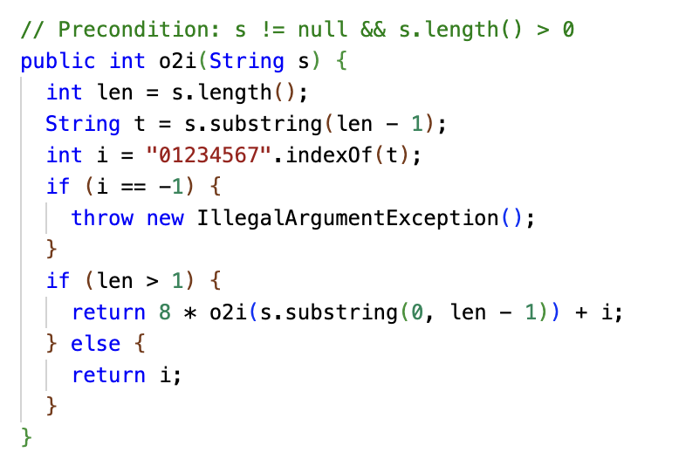
Recursive Trace Exercise (10 minutes)
What is printed?
System.out.println(o2i("4")); System.out.println(o2i("3747"));

Slide 14
Recursive Trace Exercise (10 minutes) – ANSWERS
What is printed?
System.out.println(o2i("4")); > 4 System.out.println(o2i("3747")); > 2023
o2i("3747") = 8 * o2i("374") + 7 = 8 * (8 * o2i("37") + 4) + 7
= 8 * (8 * (8 * o2i("3") + 7) + 4) + 7 = 8*(8*(8*3+7)+4)+7 = 2023

Slide 15
What was this method doing? Hexadecimal (Base 16)
What is printed?
System.out.println(i2x(500));
> 1f4 System.out.println(Integer.toString(500, 16)); > 1f4 Hexadecimal is commonly used enough that converting an int/long to a hex string is built-in to Java.

Slide 16
What was this method doing? Octal (Base 8)
What is printed?
System.out.println(o2i("3747")); > 2023 System.out.println(Integer.parseInt("3747", 8)); > 2023
Converting from String -> int, long in bases other than 10 is also directly supported by Java.

Slide 17
Hexadecimal
Computers understand binary, 1's and 0's, but binary is hard for humans to read.
1 | 0 | 0 | 1 | 0 | 1 | 0 | 0 | 1 | 1 | 1 | 0 | 0 | 0 | 0 | 1
9 |  |  |  | 4 |  |  |  | E |  |  |  | 1
When humans work with binary data, it is common to use hexadecimal (base 16). Every 4 bits (a nibble) maps to a standard digit (0-9) or one of six extra digits (A-F).
0000 | 0
0001 | 1
0010 | 2
0011 | 3
0100 | 4
0101 | 5
0110 | 6
0111 | 7
1000 | 8
1001 | 9
1010 | A (10)
1011 | B (11)
1100 | C (12)
1101 | D (13)
1110 | E (14)
1111 | F (15)

Slide 18
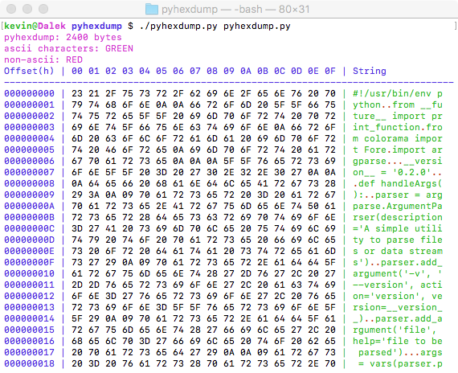

Slide 19
Octal
Octal is base 8, so 3 bits per digit, and was also used for humans to interact with binary data. It's mostly fallen into disuse, but hangs out in a few places (Unix file permissions)
0 | 1 | 1 | 1 | 1 | 1 | 1 | 0 | 0 | 1 | 1 | 1
3 |  |  | 7 |  |  | 4 |  |  | 7
3 * 8³ +
7 * 8² +
4 * 8¹ +
7 * 8⁰
= 2023
In decimal, you have a 1's place, a 10's place, a 100's place. These are powers of 10 (10⁰, 10¹, 10², 10³, ...)
In octal, each place is 8x the previous one, so 1, 8, 64, 512...
In hexadecimal, it's 16⁰=1, 16¹=16, 16²=256, 16³=4096, ...
And in binary, of course, it's powers of 2.
000 | 0
001 | 1
010 | 2
011 | 3
010 | 4
101 | 5
110 | 6
111 | 7

Slide 20
Java: 0x and 0 prefixes
In Java, we usually specify numbers in decimal (base 10). Java actually lets you write numbers in hex or octal.
An integer prefixed with 0x is hexadecimal.
An integer prefixed with 0 is octal.
System.out.println(0777); > 511 System.out.println(03747); > 2023 System.out.println(0x100); > 256

Slide 21
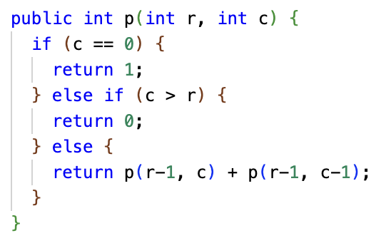
One More Recursive Trace Exercise (5 minutes)
What is printed?
System.out.println(p(3, 0));
System.out.println(p(3, 1));
System.out.println(p(3, 2));
System.out.println(p(3, 3));
Hint: Write out equations: p(3, 0) = 1 p(3, 1) = p(2, 1) + p(2, 0) p(3, 2) = ??? p(3, 3) = ???
p(2, 0) = ???
p(2, 1) = ???
p(2, 2) = ???
p(2, 3) = ???
p(1, 0) = ???
p(1, 1) = ???
p(1, 2) = ??? ...

Slide 22
One More Recursive Trace Exercise – ANSWERS
What is printed?
System.out.println(p(3, 0)); > 1
System.out.println(p(3, 1)); > 3
System.out.println(p(3, 2)); > 3
System.out.println(p(3, 3)); > 1

Slide 23
One More Recursive Trace Exercise – ANSWERS
Write out the equations, starting with what you need to solve. Base cases, handle directly.
Then, working backward from simplest to most complicated, do the substitutions.
p(3, 0) = 1
p(3, 1) = p(2, 1) + p(2, 0)
p(3, 2) = p(2, 2) + p(2, 1)
p(3, 3) = p(2, 3) + p(2, 2)
p(2, 0) = 1
p(2, 1) = p(1, 1) + p(1, 0)
p(2, 2) = p(1, 2) + p(1, 1)
p(2, 3) = 0
p(1, 0) = 1
p(1, 1) = p(0, 1) + p(0, 0)
p(1, 2) = 0
p(0, 0) = 1
p(0, 1) = 0
p(0, 0) = 1
p(0, 1) = 0
p(1, 0) = 1
p(1, 1) = p(0, 1) + p(0, 0) = 1
p(1, 2) = 0
p(2, 0) = 1
p(2, 1) = p(1, 1) + p(1, 0) = 2
p(2, 2) = p(1, 2) + p(1, 1) = 1
p(2, 3) = 0
p(3, 0) = 1
p(3, 1) = p(2, 1) + p(2, 0) = 2 + 1 = 3
p(3, 2) = p(2, 2) + p(2, 1) = 1 + 2 = 3
p(3, 3) = p(2, 3) + p(2, 2) = 1

Slide 24
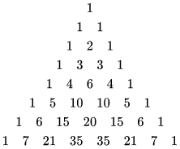
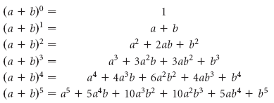
Pascal's Triangle
Pascal's Triangle, aka the Yang Hui Triangle or Khayyam Triangle, was discovered 1,000+ years ago and has applications in algebra, combinatorics, and probability theory.
p(r, c) calculates the value of Pascal's Triangle ar row r and column c
Pascal's Triangle has many interesting mathematical properties. One is that it gives the coefficients in the expansion of any binomial expression.
It can also be used to calculate the probability of a winning hand of cards!

